Slide 1
SMARK AIR

Slide 2
Table of Contents
01
02
03
04
05
06
About the Project
Project Goals
Project Sprints
Who is the team?
What is this project?
How do we determine the Project's success?
What did we accomplished in each Sprint?
Hardware/Software
What next?
Retrospective
What did we use and what did we create?
If we were to continue the project what would we do?
Were we succesful?

Slide 3






Our Team
Nathon Anderson
Curtis Ellenton
Hardware Programmer
Software Developer
Sam Nixon
Jordan Caraiman
Project Manager
Software
Developer
John Narte
Frankie Ha
Hardware Programmer
Software Developer

Slide 4
Air Quality Project
A comprehensive system that continuously monitors and analyzes the indoor air quality using sensors to accurately measure a range of critical environmental parameters including carbon dioxide (CO2) levels, temperature, humidity, as well as additional pollutants like volatile organic compounds (VOCs) and particulate matter (PM2.5 and PM10).

Slide 5
Project Goals
Portability
Affordability
Useability

Slide 6
Project Stages
All Stages
Final Product Achieved
Sprint 1
Sprint 2
Sprint 3
Procurement and Website Development
Hardware Programmed
And Website Core Features
Document Creation and all development finalized

Slide 7
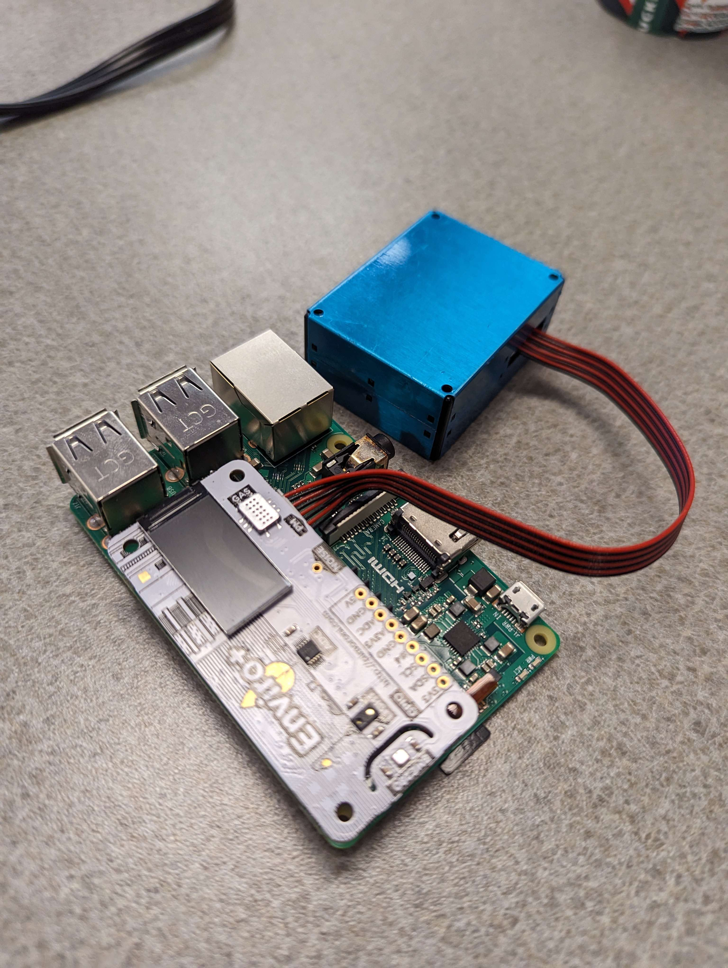
Current Hardware
Raspberry Pi 3b – $50.00
Enviro + Air Quality $69.95
PMS5003 sensor $15.59
GPS sensor - $20.00

Slide 8
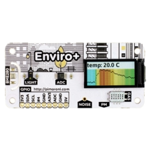
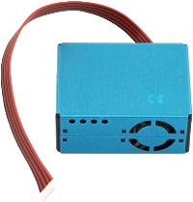
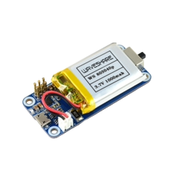
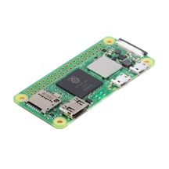
Future Hardware
Raspberry Pi Zero 2 W
Enviro + Air Quality
PMS5003 Sensor
Battery
Enclosure
New GPS sensor

Slide 9

Sensor Code Overview
Key Functions
‘getGas()’: Reads MICS6814 Gas Sensor data
‘getWeather()’: Reads BME 280 Sensor data
‘getParticulates()’: Reads PMS5003 Particulate Sensor data
‘sendData()’: Transmits compiled data to the “smarkair.com” API
Implementation Details
CPU temperature compensation applied for more accurate surrounding temperature readings
Code gathers data 10 times every 5 seconds before transmitting data to the API

Slide 10
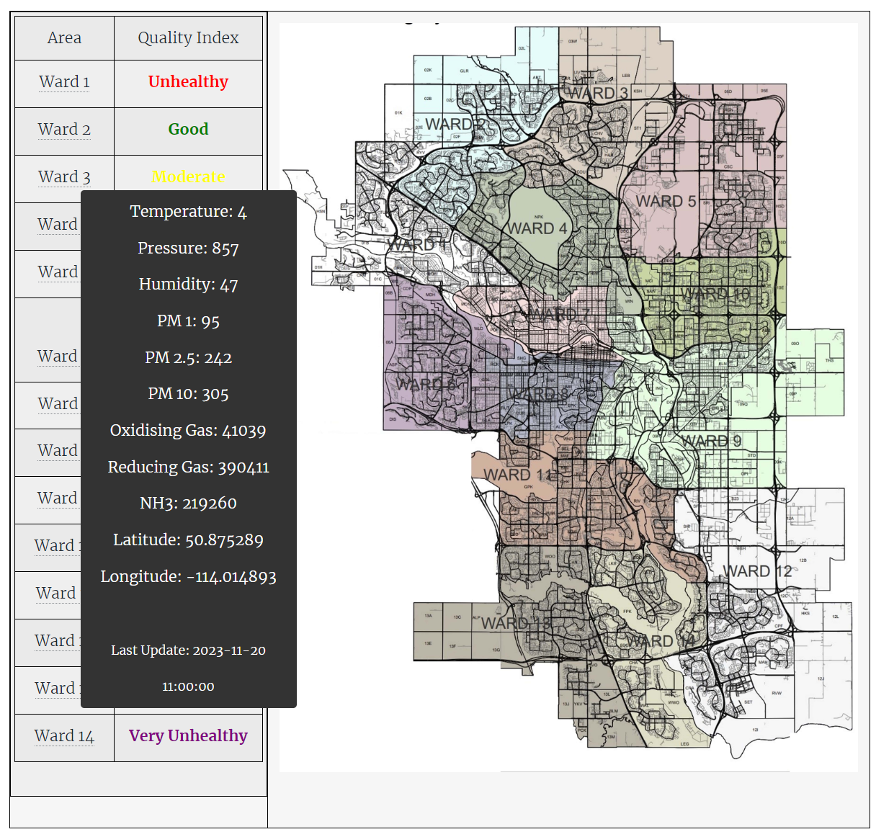
Data Collection
MICS6814 Gas Sensor
Oxidizing
Reducing
NH3
GPS
Sensor
BME 280
Sensor
Temperature
Pressure
Humidity
Latitude
Longitude
PMS5003 Particulate Matter Sensor
PM1.0
PM2.5
PM10

Slide 11



Hosting
AWS Lightsail
MySQL Database
Cloudflare
Simplified cloud computing with easy setup. Launch websites, apps, and databases quickly and cost-effectively without complex infrastructure management
Empowering websites with speed, security, and reliability. A global network optimizing performance and protecting against online threats seamlessly
Part of Amazon Lightsail, it is a highly available, managed database allowing scalability and integrated tools such as backup and security settings

Slide 12

Database
High Availability databases
We have opted for High-availability plan databases, which are established in an extra Availability Zone to enhance stability and redundancy

Slide 13

Source Code Management
GitHub
To better manage our source code a GitHub repository was created for better organization and better collaboration.

Slide 14



Future Features
Geolocation Webpage
Mobile App
Adding Secondary Devices
Users can access data through the mobile app, and the webpage. Notifications will be sent via the app, not email
User’s can add more devices to their Smark Air account.
User’s will be able to see their device location and data on a webpage made with a google maps API key.

Slide 15
Retrospective

Slide 16
Demo

Slide 17
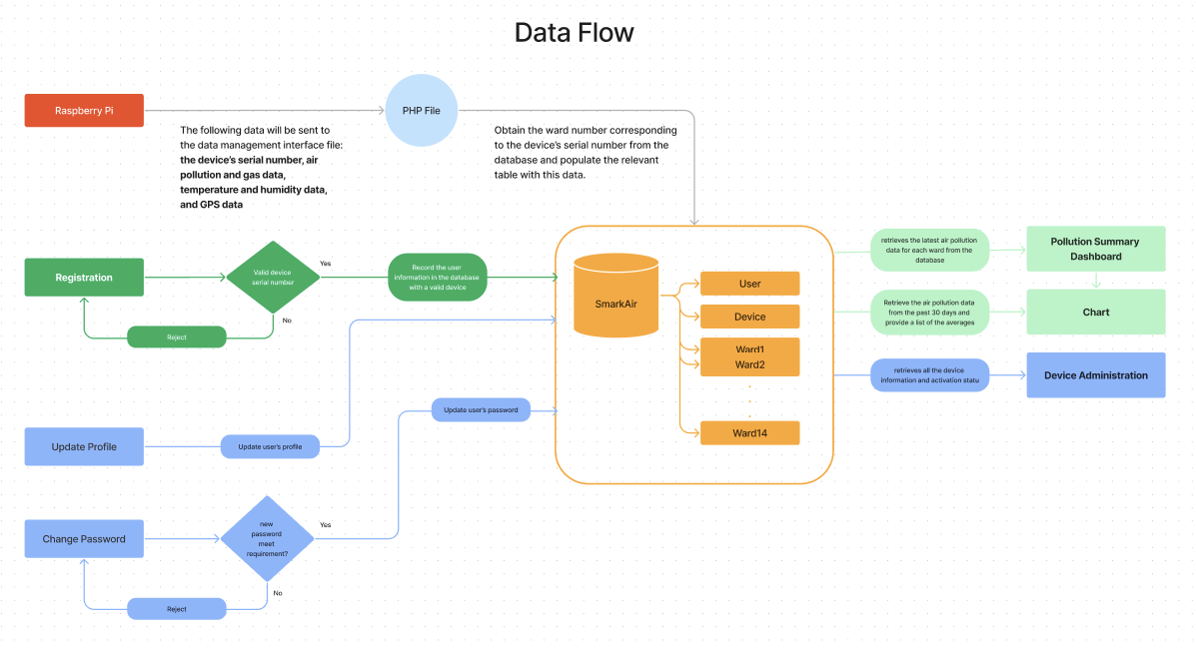

Slide 18
Applied Security Measures
Cloudflare
Cloudflare safeguards websites through a multi-layered approach to security. Its global network provides DDoS protection, mitigating malicious traffic and ensuring website availability. The Web Application Firewall (WAF) filters out common web application attacks, while free SSL/TLS certificates encrypt data in transit. Cloudflare's CDN accelerates content delivery globally, reducing latency and improving performance. Bot management distinguishes between legitimate and malicious bots, and DNS security features protect against various DNS-related threats. Rate limiting, access control, and an Always Online feature further contribute to a robust defense against cyber threats, making Cloudflare an integral part of comprehensive website security.
Disable public mode of the database on AWS
Disabling public access to your AWS database provides a crucial security advantage by minimizing the risk of unauthorized access and potential exploits. This approach enhances network isolation, reduces the attack surface, and helps meet compliance standards. It prevents unauthorized connections, mitigates the risk of denial-of-service attacks, and allows for cost optimization by controlling data transfer. Additionally, secure access can be maintained through VPN or DirectConnect, enabling customized security controls and facilitating easier auditability of database access. Overall, this measure strengthens the database's security posture, protecting sensitive data from potential threats.

